Slide 1
Case Management System
Partner Delivery Bootcamp - Final Presentations

Slide 2
Agenda
01 | Use Case Overview (2 min)
02 | Process Flow (1 min)
03 | Recipe Build Review & Demo (6 min)
04 | Testing & Deployment Strategy (2 min)
05 | Closing (2 min)
06 | Questions & Feedback (3 min)

Slide 3
Introductions
Image
Image
Chanakya
Suryakant
Deloitte
Deloitte
Image
Image
Image
Nilanjana
Mrinalini
Shivansh
Deloitte
Deloitte
Deloitte

Slide 4
01
Use Case Overview

Slide 5
Use Case Overview
Use Case Title | Automated Case Desk
Department(s) Involved | L1 Support Team, Dev Support team
Application(s) Involved | Salesforce, JIRA, Slack, Workbot,
Business Problem | Faster notification , resolution and reporting of high-priority cases
Proposed Solution | This automation brings down the instances of missed high priority cases by creating automated JIRA tickets for the concerned team to monitor. Also, the Slack message helps with the much-required notifications so anyone who is on-call or disturbed rotation can keep an eye on such high priority notifications.

Slide 6
02
Process Flow

Slide 7
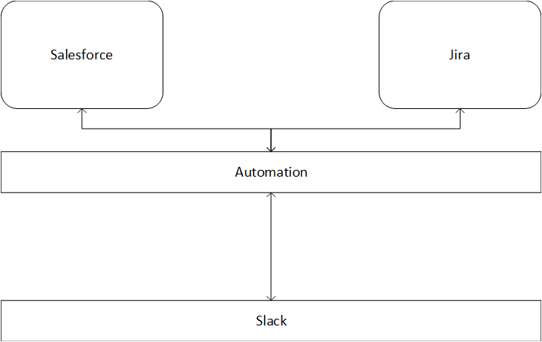
Process Flow

Slide 8
Process Flow
Salesforce to JIRA data transfer

Slide 9
Process Flow
JIRA to Salesforce data transfer

Slide 10
03
Recipe Build Review & Demo

Slide 11
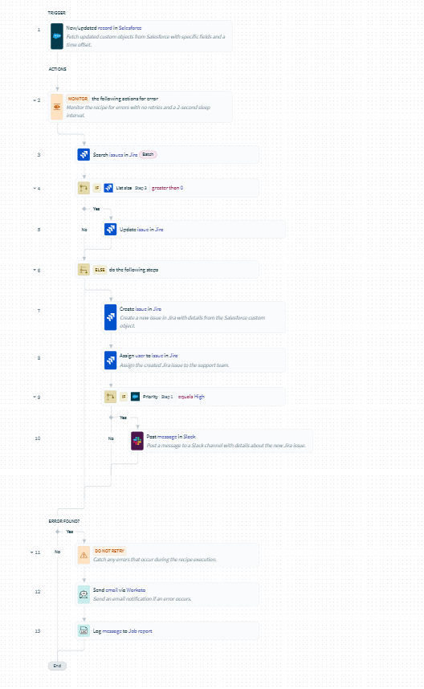
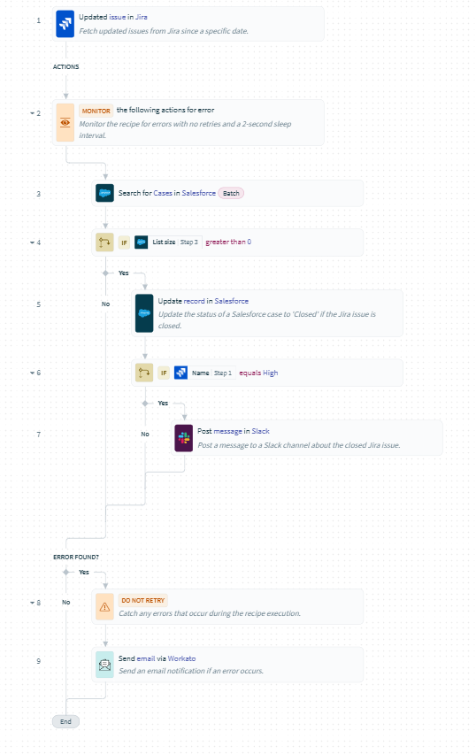
Recipe Build Review
Forward Flow

Slide 12
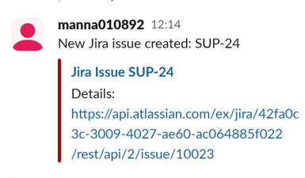
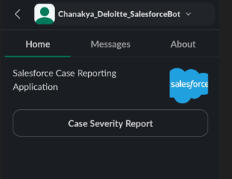
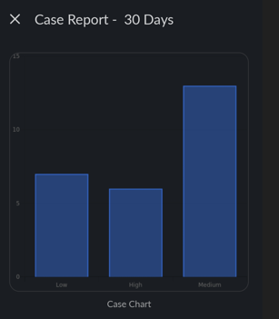
Recipe Outcome
Ticket Creation
Slack Notification
Monthly Report

Slide 13
Recipe Demo
Case : High Priority Case Creation in Salesforce
Expected Outcome : 1. Jira Issues to be created 2. Slack notification

Slide 14
05
Closing

Slide 15
Closing
Problem Statement : The existing process for managing newly created cases in Salesforce and corresponding issues in JIRA is manual, inefficient, and prone to errors. This results in:
Manual Data Entry
Delayed Response
Data Inconsistency
Inefficient Collaboration: problem statement
Solution : Developed an automated utility that would listens for newly created cases in Salesforce, Automatically creates corresponding issues in JIRA and Sends real-time notifications on Slack for high-priority issues:
Automation and Efficiency
Improved Accuracy and Consistency
Enhanced Collaboration
Enhanced Monitoring and Reporting
Improved Customer Satisfaction
Future Enhancements:
Create Workbot for the Managers to interact with high priority defects which were not responded to in 24 hours
Workflow App to track high wait time cases and escalate as per escalation matrix
Incorporate AI Analytics to check most common case root cause and suggest flows to automate it.

Slide 16
Test Cases
Forward Flow
Test Cases | Expected Result
High Priority Case Creation in Salesforce | 1. Jira Issues to be created 2. Slack notification
Low Priority Case Creation in salesforce | 1. Jira Issues to be created
Case Update in Salesforce | Jira issues to be updated
Error while jira upate/create | 1. Email Notification 2. Logging
Error while posting slack notification | 1. Email Notification 2. Logging

Slide 17
06
Questions & Feedback

